Slide 1
Deep Meta Metric Learning
Zhu Min

Slide 2
Introduction
In this paper, the authors propose a deep meta metric learning (DMML) method, which formulates the metric learning process in a meta way and learns set-based distances, instead of sample-based ones.
In detail , sampling multiple subsets from the original training and learning a general metric across different subsets, called meta metric.
In each episode, sampling a subset as a new task and splitting the training data into a support set as well as a query set. The authors define the support samples in each class as a “meta-cell”, and optimize the model to match the query sample with positive meta-cell by set-based distance.

Slide 3
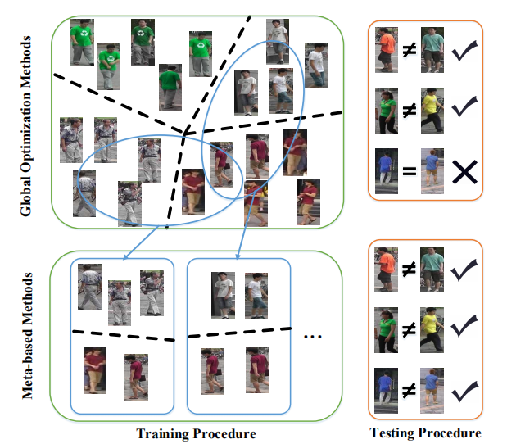
Introduction
Figure 1. Difference between global optimization methods and meta-based methods.

Slide 4
Related Work
Metric Learning:
Metric Learning aims to learn a distance function to measure the similarity of a pair of samples. Early metric learning methods learn a linear Mahalanobis metric for similarity measurement. As linear metric learning approaches usually suffer from nonlinear correlations of samples, deep metric learning methods have been proposed to learn discriminative nonlinear embeddings by deep neural networks.
Deep metric learning methods can mainly be divided into three categories: contrastive loss with pair-wise inputs, triplet loss with triplet inputs, and N-pair loss with batch inputs.
These methods hardly explain the generalization capacity of metric from training dataset to testing dataset.

Slide 5
Related Work
Meta Learning:
The goal of meta learning is to enable a base learning algorithm to adapt to new tasks efficiently, by extracting some transferable knowledge from a set of auxiliary tasks.
The authors improve the set-based distance of meta formulation with hard sample mining strategy to accelerate the learning process.

Slide 6
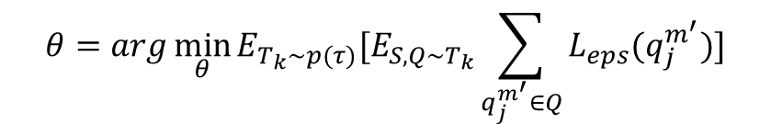
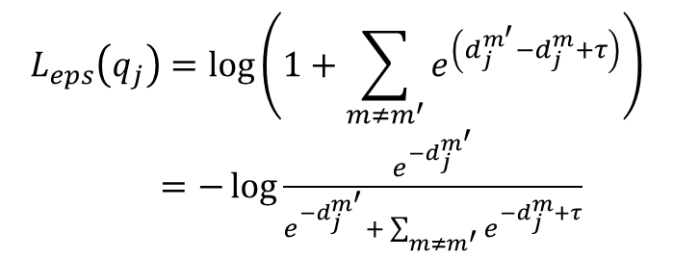
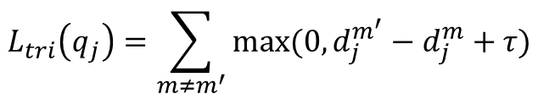
DMML method
Objective function of the proposed DMML method:
$$θ=arg\min_{θ}{E_{T_{k}\sim p(τ)}[E_{S,Q\sim T_{k}}\sum_{q_{j}^{m^{′}}∈Q}{L_{eps}(q_{j}^{m^{′}})}]}$$
Where, the loss function is:
$$L_{eps}\left(q_{j}\right)=\log\left(1+\sum_{m≠m^{′}}{e^{\left(d_{j}^{m^{′}}−d_{j}^{m}+τ\right)}}\right)$$
$=−\log{\frac{e^{−d_{j}^{m^{′}}}}{e^{−d_{j}^{m^{′}}}+ \sum_{m≠m^{′}}{e^{−d_{j}^{m}+τ}}}}$
$$L_{tri}\left(q_{j}\right)=\sum_{m≠m^{′}}{max⁡(0,d_{j}^{m^{′}}−d_{j}^{m}+τ)}$$

Slide 7
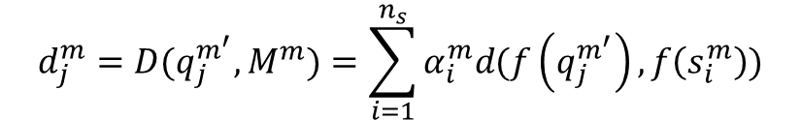
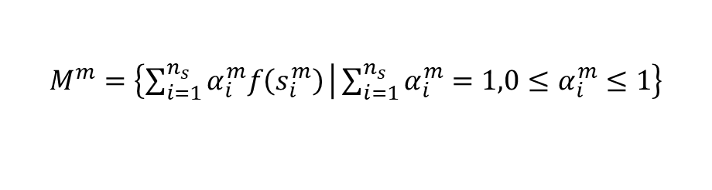
DMML method
The distance between the query sample and the meta-cell is:
$$d_{j}^{m}=D(q_{j}^{m^{′}},M^{m})=\sum_{i=1}^{n_{s}}{α_{i}^{m}d(f\left(q_{j}^{m^{′}}\right),f\left(s_{i}^{m}\right))}$$
Where, the meta-cell is:
$$M^{m}=\left\{\sum_{i=1}^{n_{s}}{α_{i}^{m}f\left(s_{i}^{m}\right)} | \sum_{i=1}^{n_{s}}{α_{i}^{m}=1,0≤α_{i}^{m}≤1}\right\}$$
However, this general definition is difficult to optimize directly. Therefore, the authors propose two alternative set-based distances: center support distance and hard mining distance.

Slide 8
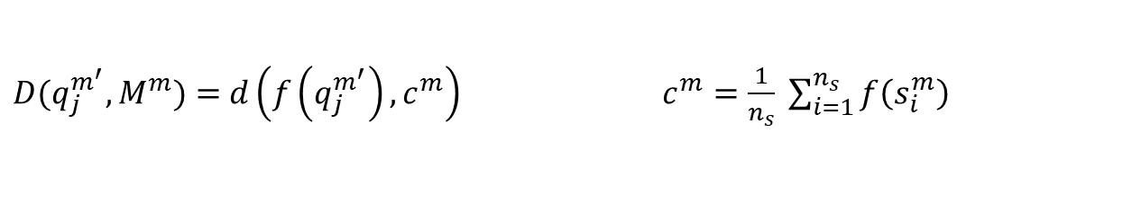
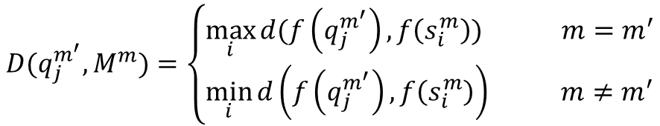
DMML method
center support distance : it uses the center point of samples in a meta-cell to represent the whole meta-cell and computes the point-to-point distance.
$D(q_{j}^{m^{′}},M^{m})=$ $d\left(f\left(q_{j}^{m^{′}}\right),c^{m}\right) c^{m}=\frac{1}{n_{s}} \sum_{i=1}^{n_{s}}{f\left(s_{i}^{m}\right)}$
In center support distance, hard samples and easy samples are treated equally, which violates the principle of hard sample mining.
hard mining distance : it selects the nearest support point from each negative meta-cell and the farthest point from the positive meta-cell.
$$D(q_{j}^{m^{′}},M^{m})=\left\{\begin{aligned}\max_{i}{d(f\left(q_{j}^{m^{′}}\right),f\left(s_{i}^{m}\right))} m=m^{′} \\ \min_{i}{d\left(f\left(q_{j}^{m^{′}}\right),f\left(s_{i}^{m}\right)\right) }m≠m^{′}\end{aligned}\right.$$

Slide 9
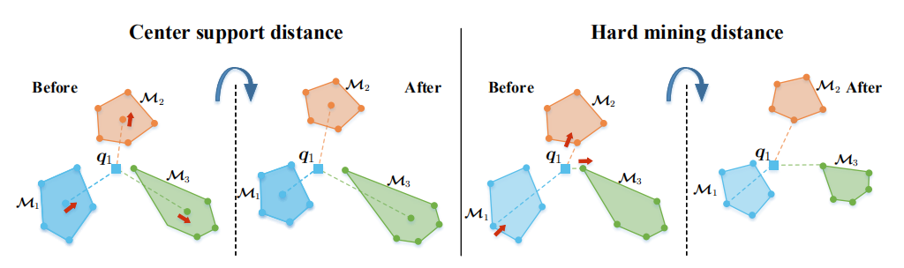
DMML method
Figure 2. Center support distance and hard mining distance in DMML.

Slide 10
DMML method
Algorithm 1 : DMML
Require: Training image set, the number of classes in the training set N, the number of classes sampled per episode M (M ≤ N), the number of support instances per class ns, the number of query instances per class nq, margin parameter τ , max episode number T. Ensure: Parameters θ of the embedding function f(·). 1: Initialize θ. 2: for episode = 1, 2, · · · , T do 3: Randomly sample M class indices from N. 4: Randomly sample support set and query set for each class. 5: Compute distances between each query sample and all meta-cells . 6: Optimize θ. 7: end for 8: return θ.

Slide 11
Experiments
The authors evaluate the proposed DMML method on three visual recognition tasks: person re-identification ,vehicle re-identification, and face verification. In addition, the authors conducted ablation experiments and did parameter analysis to investigate the robustness of DMML.
The experiments employ ResNet-50 as basic network architecture and set the class number of each sub-task and the number of support samples in each meta-cell to M = 32 and ns = 5 respectively, and fixed margin parameter τ = 0.4 in our negative-margin-based objective function .During training, the experiments applied Adam Optimizer and set the base learning rate to 0.0002.

Slide 12
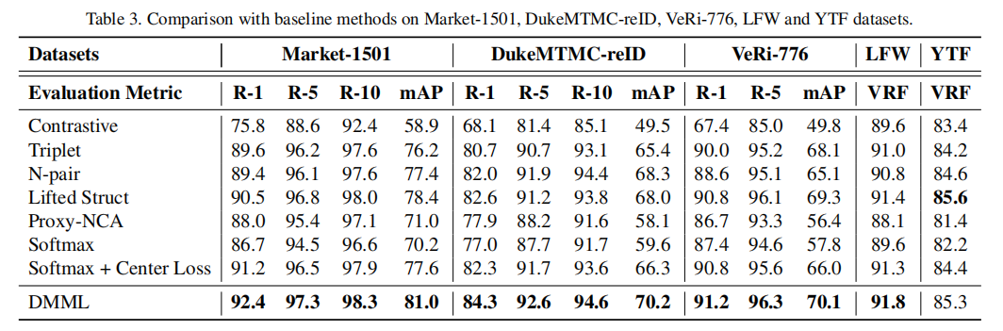
Experiments
Table 1. Comparison with baseline methods on Market-1501, DukeMTMC-reID, VeRi-776, LFW and YTF datasets.

Slide 13
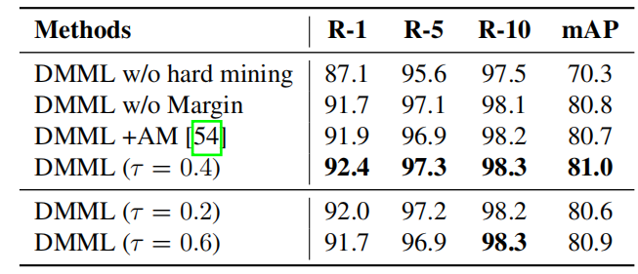
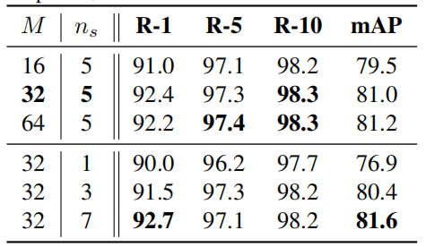
Experiments
Table 2. Results of ablation experiments on hard mining distance and margin strategy on Market-1501 dataset.
Table 3. Results with different numbers of selected classes M and support samples ns on Market-1501 dataset.

Slide 14
THINK YOU!
Zhu Min

